Slide 1

Financial Sentiment Analysis
Ton Nattapan
Mini project 3

Slide 2
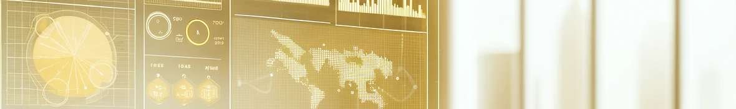
Agenda
Financial News Overview
Business Problem
Exploring Data Analysis
Project Pipeline
Model Evaluation
Conclusion

Slide 3
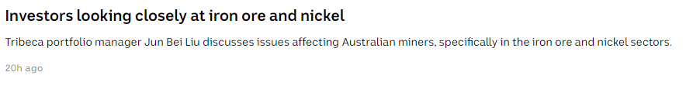
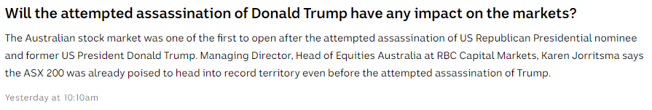
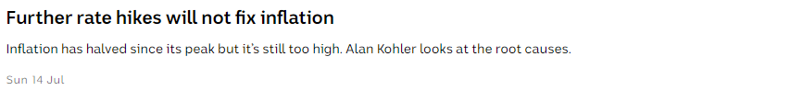
Financial News Overview
Neutral, Positive, Negative?
Neutral, Positive, Negative?
Neutral, Positive, Negative?

Slide 4
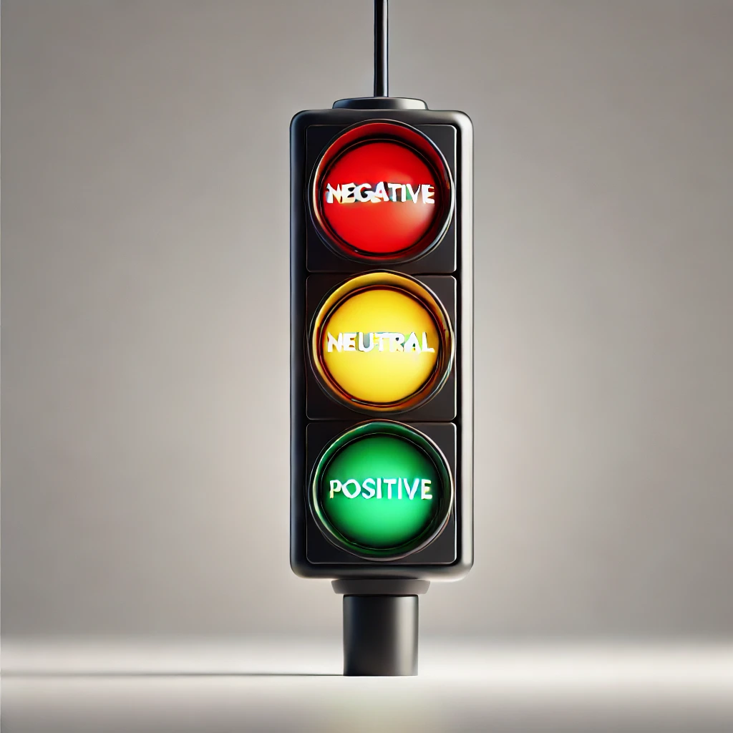
Business Problem
Problem
Stakeholder: Investors, Business owners
Question: Can we automatically classify financial news as 'negative,' 'neutral,' or 'positive' for the financial market?

Slide 5
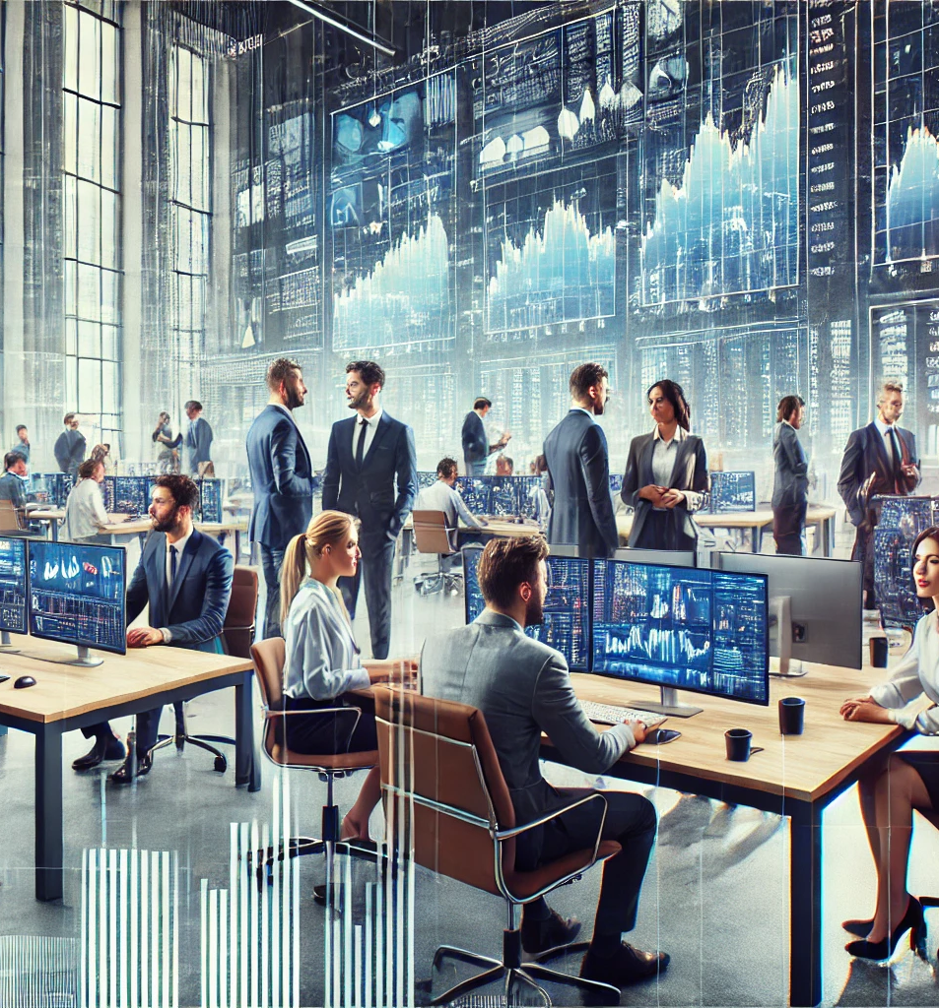
Business Problem
Application
Investors:
Positive - good investment opportunities (buy).
Negative - review of current investments (sell).
Business owners:
Positive - suggests overall market confidence (expand).
Negative - possible market downturns, leading to cautious financial planning and risk mitigation strategies (shrink).

Slide 6
Exploring Data Analysis
Dataset: PhraseBank
Source: Hugging Face
Dataset contains sentences extracted from financial news articles, each labeled with a sentiment (positive, negative, or neutral)
2,264 rows

Slide 7
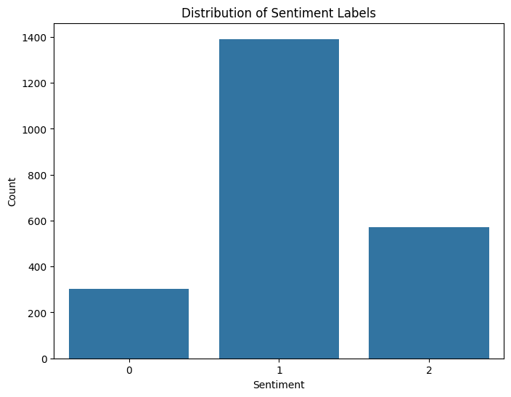
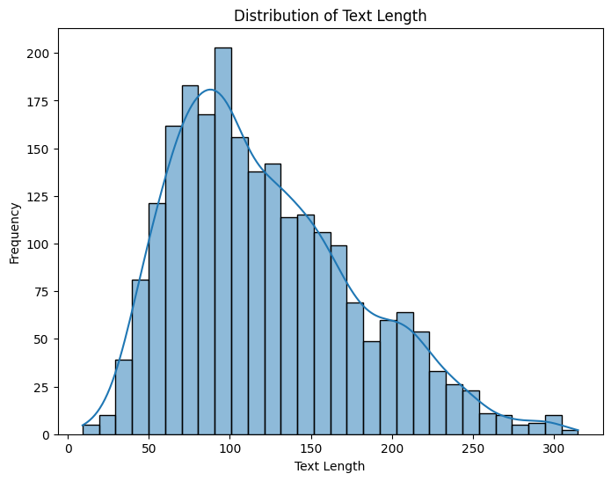
Exploring Data Analysis
Negative': 0, 'Neutral': 1, 'Positive’: 2
Majority are neutral, with more positive than negative.
The majority of words in the sentences range between 50 and 200.

Slide 8
Project Pipeline
Data processing
Split data
Model training
Model evaluation
Conclusion
Convert sentences into tokens
80% training and 20 % testing
Using BERT
Accuracy
Precision
Can we use the model?
Further work
Recall, F1

Slide 9
Model Evaluation
Negative : 0
93% were correctly classified
Neutral : 1
98% were correctly classified
Positive : 2
94% were correctly classified
Overall
High precision, recall, and F1-scores across all classes
The overall accuracy of the model is 96%
Excellent classification performance

Slide 10
Conclusion
Can we automatically classify financial news as 'negative,' 'neutral,' or 'positive' for the financial market?
YES at 96% accuracy!!!
Further development
Deploy to the server
Stream financial news and automatically classify its sentiment

Slide 11
Thank you.
Any question?

